Slide 1
Using Level 1 Reports for Remediation
Lorena Stabins
lstabins@bocesmaars.org
585-349-9068
Ryan Maier
rmaier@monroe2boces.org
585-349-9063

Slide 2
Level 1 Reports Overview
A variety of reports that can tell how a group of students performed or how a specific student scored
Unlike reports found in ASAP, many Lvl 1 reports show how students performed on content standards with gap analysis
Reports for January 2020 Regents will be available at the tentative date of February 17th
Reports for June exams usually come in mid-July

Slide 3
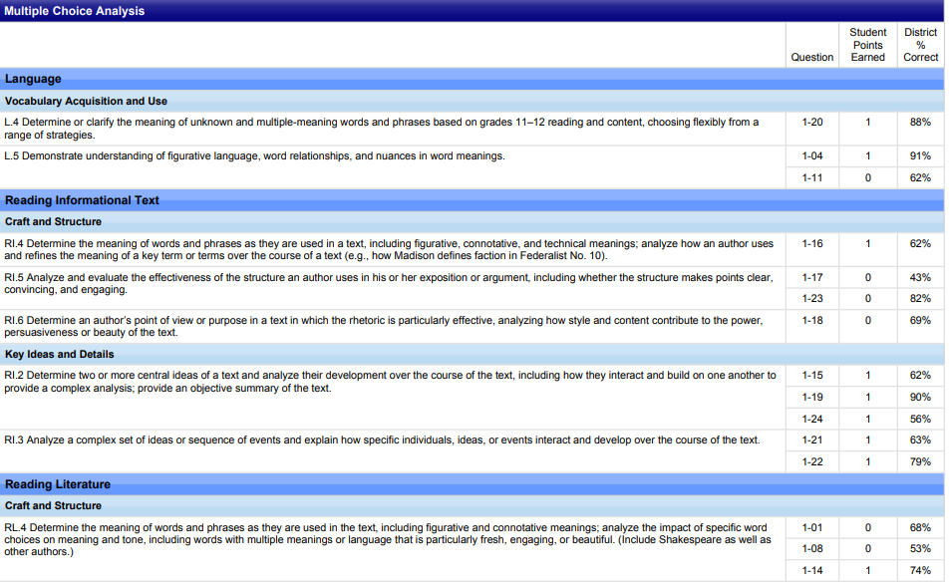
Comparison
ASAP
Level 1 – Indiv. Student Report

Slide 4
Navigation to “Individual Student Report by Subskill”

Slide 5
Use the Questions Individually filter to see the Question numbers

Slide 6
Using Level 1 Reports in the classroom
Since Level 1 Reports can show a student’s strengths and weaknesses in regards to standards, a teacher can use the report to guide instructional intervention
Individual Student Performance by Subskill

Slide 7
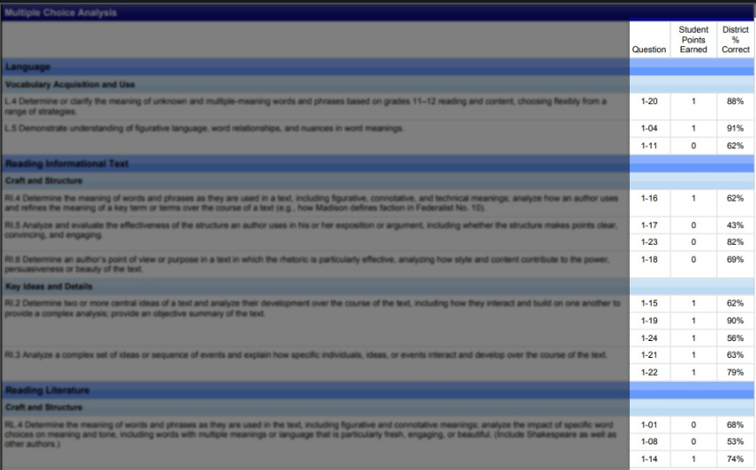
Using Level 1 Reports in the classroom
Since Level 1 Reports can show a student’s strengths and weaknesses in regards to standards, a teacher can use the report to guide instructional intervention
The student scored
perfectly in this section!

Slide 8
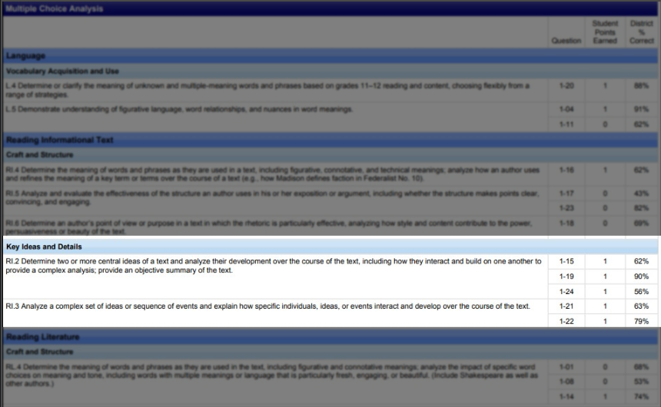
Using Level 1 Reports in the classroom
Since Level 1 Reports can show a student’s strengths and weaknesses in regards to standards, a teacher can use the report to guide instructional intervention
See where they do well and celebrate with them!
These 3 questions are particularly impressive considering the gap to the District!

Slide 9
Using Level 1 Reports in the classroom
Since Level 1 Reports can show a student’s strengths and weaknesses in regards to standards, a teacher can use the report to guide instructional intervention

Slide 10
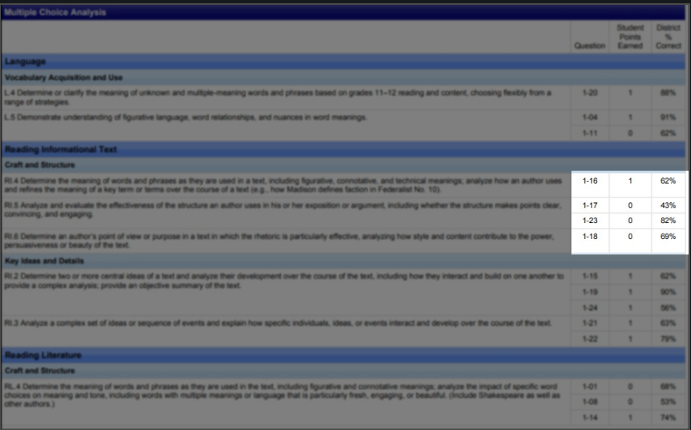
Using Level 1 Reports in the classroom
Since Level 1 Reports can show a student’s strengths and weaknesses in regards to standards, a teacher can use the report to guide instructional intervention
Weakness area
Most of the other students got these 2 correct. What happened with our student here?

Slide 11
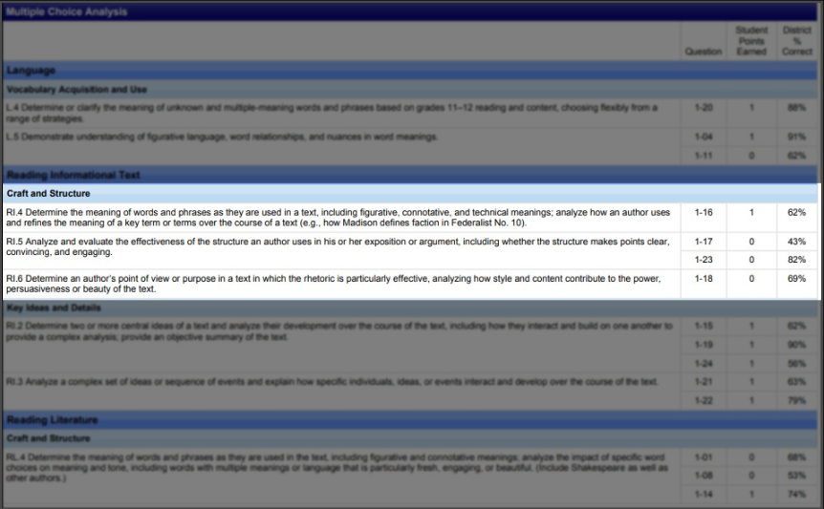
Using Level 1 Reports in the classroom
Since Level 1 Reports can show a student’s strengths and weaknesses in regards to standards, a teacher can use the report to guide instructional intervention
Now we know a standard area to target to help this student!

Slide 12
Insight into Student’s Thinking
For a student who just took a Regents test, a teacher or counsellor can sit down with a student and go over the questions that he/she missed while it is fresh in their memory
Reports that show a student’s answer choice may give a teacher insight into the student’s thinking
“Why did he choose that answer?”

Slide 13
Report: Item Responses per Student

Slide 14
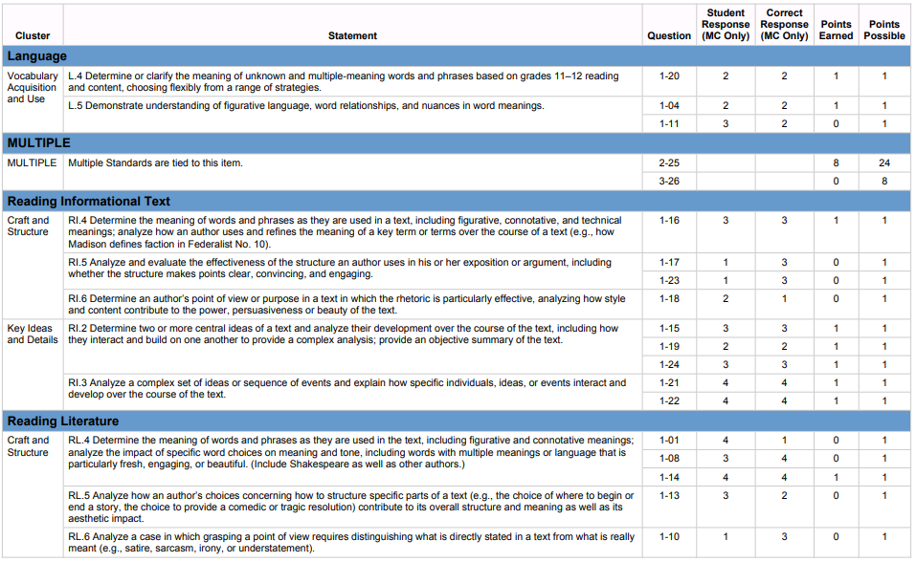
Report: Item Responses per Student
Remember the problem standards from the last report?

Slide 15
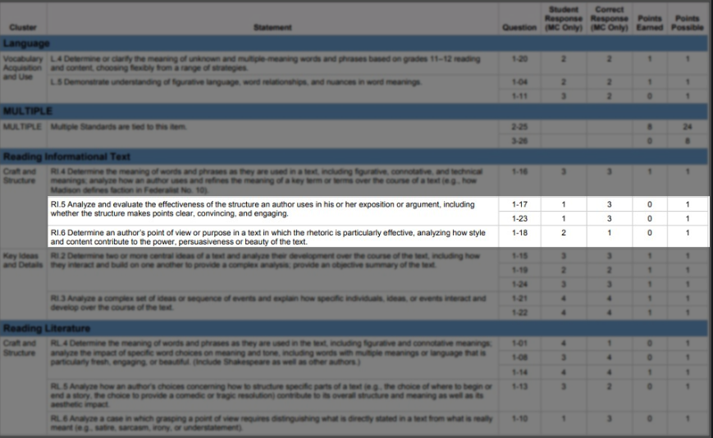
Report: Item Responses per Student
Use the test to see the questions and answer choices.

Slide 16
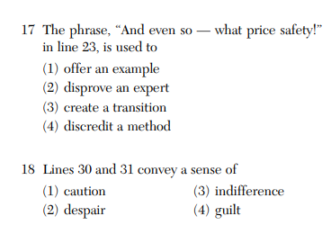
Now look at the exam!
Student’s answer
Correct answer
Next Step: Ask yourself why he chose #1. How can I teach him that this is a transitional phrase?

